Slide 1
Vmware Vfabric – RabbitMQ

Slide 2
Messaging in the Cloud
Need new levels of scalability
▪ Need a standardized wire protocol
• Won't ship a specific client for each environment
• Better interoperability
▪ JMS only defines an API and behavior, but no protocol
▪ AMQP defines a protocol

Slide 3
Why AMQP?
Interoperability – like TCP and unlike JMS
• RabbitMQ leading the 2009 interoperability push around AMQP 0-9-1 towards
AMQP 1.0
▪ Multiple vendors on one open, royalty-free standard
• You are not locked in
• Lower risk, lower price because of competition, easier to compare
• Products specialized around different areas of value e.g low latency, high
stability, wide area
▪ Efficient – designed for today’s pubsub and queueing needs
• Binary wire protocol
• Support in all major languages
• Supported on most OS platforms
▪ Already in use by many major companies
▪ Future proof – backed by Cisco, Microsoft, VMware and many more

Slide 4
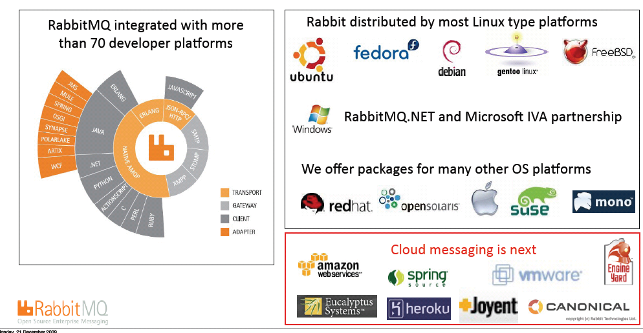
Broad platform and vendor support...

Slide 5
Key AMQP messaging protocol requirements
▪ Internet protocol - like HTTP, TCP - but ASYNCHRONOUS
▪ Ubiquity: Open, easy & low barrier to use, understand and
implement
▪ Safety: Secure and trusted global transaction network
▪ Fidelity: Well-stated message queuing, ordering and delivery
semantics
▪ Applicability: any broker can talk to any client, support common
messaging pattern and topologies
▪ Interoperability
▪ Manageability: Binary, scalable

Slide 6
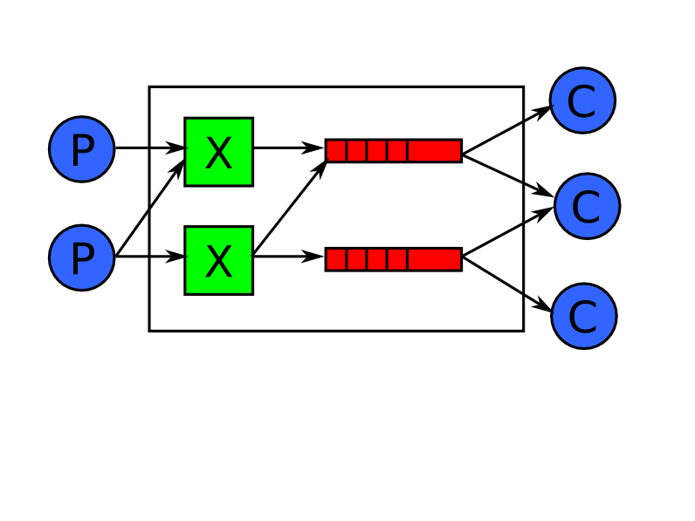
AMQP in a nutshell

Slide 7
Exchange Types: Matching Algorithms
Direct
• Routes on a routing key
• Two direct exchanges always exist
• amq.direct and the default exchange (with no public name) are mandatory
▪ Topic
• Routes on a routing pattern
• amq.direct is mandatory if the server supports topic exchanges
• Which it should according to the spec (whereas direct and fanout must be supported)
▪ Fanout
• Simple broadcast to all bound queues (no args when binding). Fast
• amq.fanout is mandatory

Slide 8
AMQP in detail
Messages are stateless
Exchanges are stateless routing tables
Queues buffer messages for push to customers
Queues are stateful, ordered can be persistent, transient, private or shared.
Order might change if the messages are redelivered

Slide 9
AMQP in detail
Queues are bound to named exchanges.
Binding can have a pattern e.g. “tony” (direct exchange) or “*.ibm.*” (topic exchange)
Producers send messages to exchanges with routing key e.g. “tony”, or ordered set of keys e.g. “buy.ibm.nyse”
Exchanges route messages to queues whose binding pattern matches the message routing key or keys

Slide 10
Sample Code

